Slide 1
Bioinformatics Workshop #1
Dr. Hwang Lab
1/19/2018

Slide 2
Announcement
Anybody does not bring a CCF-certified laptop?
Dr. Hwang lab
Changjin, Yunku, and Jean
Restroom location
9 to 5 PM (Lunch: noon to 1 PM)
1 hour PPT slides
Rest of the hours: Exercise in Linux servers

Slide 3
Agenda
9 to 9:20: Setup connection
9:20 to 10:30 Introduction to Bioinformatics
10:40 to 11:20 Linux Basics
11:25 to 12 Bash Shell Scripts
Lunch
1 to 1:50 QC FASTQ files
2 to 2:25 : Alignments
2:30 to 3:00 : Post processing alignments
3:05 to 3:35 : GATK variant calls
3:45 to 4:30 : VCF and annotation
4:40 to 5:00 : Consulting

Slide 4
Welcome and Setup
Tell me about yourself (your research interest and computer skill)
Form a group with two
Anybody does not bring a CCF-certified laptop?
Connect to CCF network
Assigning Linux server IP address to each of you

Slide 5
Introduction to Bioinformatics
Big data era
Successful NGS applications
Experiment design
Overall Bioinformatics pipeline structure
Next-generation sequencing technology (Jean)
Illumina
Nanopore
Alignment (Yunku)
BWA-mem
HISAT
NCBI BLAST (demo)

Slide 6
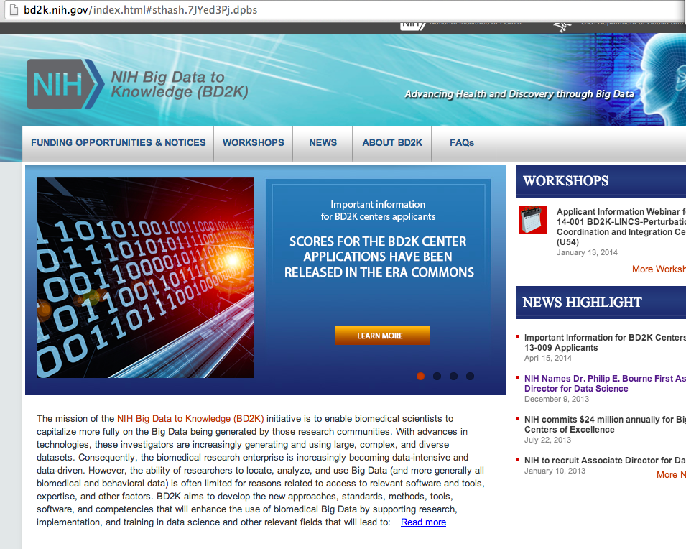
What is Bioinformatics?
Handling massive heterogeneous biological data
What is Bioinformatics?
Application of techniques from computer science, statistics, mathematics, and engineering to problems from biology
Interdisciplinary
Genomics
Proteomics
Metabolomics
Metagenomics
and etc.

Slide 7
Human genome project
Human genome project (start date: 1990 ~ complete date: Feb. 2001)
Goal: Sequence and identify ~ 3 billions base pairs in the human genome. Ultimately find the genetic roots of disease and develop treatments
10 years and 3 billion dollars

Slide 8
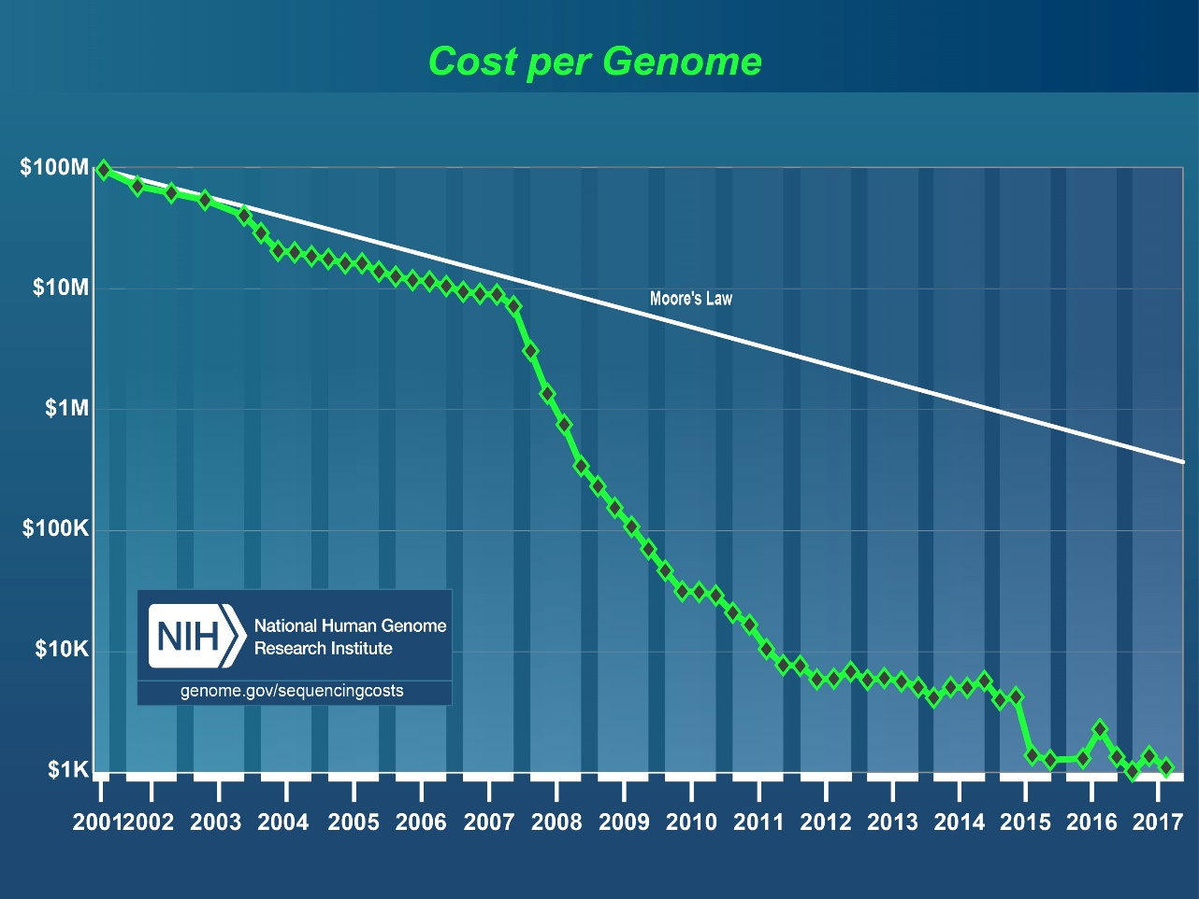
Cost per genome
Cost per genome has been significantly dropped

Slide 9
Biological data
Slide from Michael Schatz

Slide 10
How much is a Petabyte?
Name | Name in Byte | Number of Zeros | Groups of 3 Zeros | Example
One | Byte
Thousand | Kilobyte | 3 | 1 | 10 KB word doc file
Million | Megabyte | 6 | 2 | 3.4 MB mp3 song
Billion | Gigabyte | 9 | 3 | 4.7 GB DVD
Trillion | Terabyte | 12 | 4 | 4.0 TB external hard drive
Quadrillion | Petabyte | 15 | 5 | 10K human genomes
Quintillion | Exabyte | 18 | 6 | ?
Sextillion | Zettabyte | 21 | 7 | 10B human genomes
Notes:
https://www.thoughtco.com/zeros-in-million-billion-trillion-2312346

Slide 11
How much is a Petabyte?
Slide from Michael Schatz

Slide 12
DNA Data Tsunami
Slide from Michael Schatz

Slide 13
DNA Data Tsunami
Slide from Michael Schatz

Slide 14
Application
DNA sequencing helped to save Nicholas Volker
Notes:
Symptom
Found a suspicious mutation

Slide 15
Application
A bone marrow transplant of cells taken from umbilical chord blood
Notes:
Bone marrow transplant

Slide 16
Application
“Finding a needle in a haystack”
The Wisconsin scientists who decoded Nicholas' DNA are writing up the case for a medical journal. In late March, David Dimmock, a Children's Hospital genetics specialist, described the work at a meeting of the American College of Medical Genetics in Albuquerque, N.M. Dimmock explained the extensive search that took scientists from a list of more than 16,000 variations - departures from the normal genetic sequence - to the single one responsible for the boy's illness.
Notes:
Finding a needle in the stack

Slide 17
Application
Joshua brain had been swelling with fluid

Slide 18
Application
Identified root of illness in 2 days + 96 min

Slide 19
Application
Another exciting story

Slide 20
Application
Optimal dosing of a drug for patients
Notes:
Polymorphism in Cytochrome (an enzyme expressed in liver) vs. tricyclics efficacy

Slide 21
Application
Another exciting story

Slide 22
Application
Another exciting story

Slide 23
Experimental design
What are my goals?
SNPs, Indels, and Structural Variations
DNA-Seq (Targeted, Whole exome, or Whole genome sequencing)
Transcriptome assembly (RNA-Seq)
Differential expressed genes (RNA-Seq)
Identify rare transcripts (RNA-Seq)
What are the characteristics of the organism to study?
Large, complex genome
Introns and high-degree of alternative splicing
no reference genome or transcriptome

Slide 24
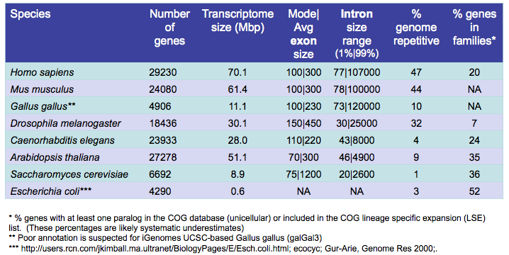
Experimental design

Slide 25
Sequencing Depth vs. Cost
Items | Values | Cost
# of flowcell | 2 (Dual flow cell)
Reads Passing Filter in HiSeq 2500 | 600 million | $2,000 Rapid run mode (SBS Kit v2)
Read length | 2x100 bp
Undetermined index rate | 0.05
Region covered by Agilent SureSelect V6 kit | 60Mb | $4,779
FASTQ to BAM conversion rate (after dedup/removing off-target reads) | 0.75
# of samples to load/flowcell | 8
Expected sequencing depth | 90x = 600M*200bp*(1-0.05)*0.75/(2*8*60M)

Slide 26
Experimental design
Technical replicates (GIAB as a reference material in clinical settings)
Identical sample but any variation in both wet lab and dry lab protocols
Not needed: low technical variation
Minimize batch effects/Randomize sample orders
Biological replicates
Not needed for transcriptome assembly
Essential for differentially expressed genes discovery
Difficult to estimate, but …we recommend
3+ for cell lines, 5+ for inbred lines, 20+ human samples

Slide 27
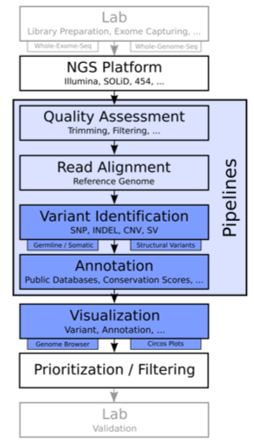
Typical pipeline

Slide 28
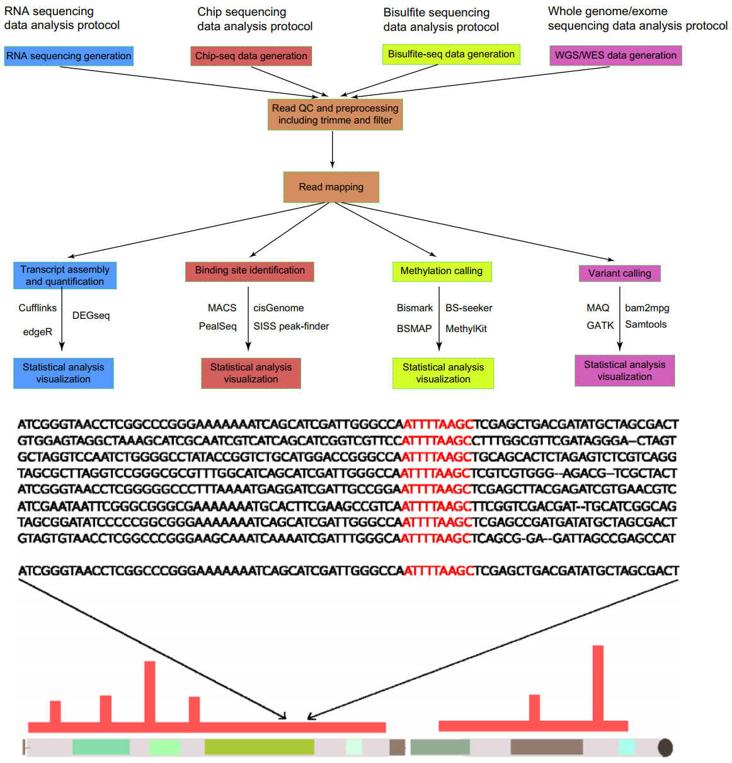

Slide 29
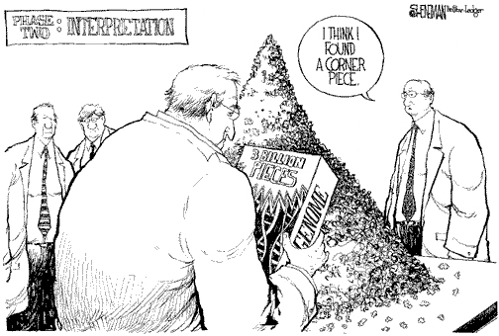
Interpretation and Bioinformatics role
Connecting dots among routine analysis modules
Data process (C++/Java/Perl/Python) and visualization (R)
To reduce both cost and time to narrow down a potential hypothesis
To discover a significant signal from heterogeneous massive data
Data driven approach

Slide 30
NGS technology
Illumina
Nanopore

Slide 31
Alignments
BWA-mem
HISAT
NCBI BLAST

